Slide 1


GNS HR SOLUTIONS
Professional Workforce & HR Management Services

Slide 2


About Us
GNS HR Solutions is a professional workforce management and human resource service provider committed to delivering reliable, efficient, and cost-effective manpower solutions across various industries. We specialize in providing skilled and unskilled manpower, recruitment services, staffing solutions, HR outsourcing, industrial labour supply, and legal compliance support.
Our objective is to bridge the gap between employers and talented workforce by providing qualified candidates who contribute to organizational growth and productivity. With a strong focus on quality, compliance, and customer satisfaction, we help businesses meet their workforce requirements efficiently.

Slide 3
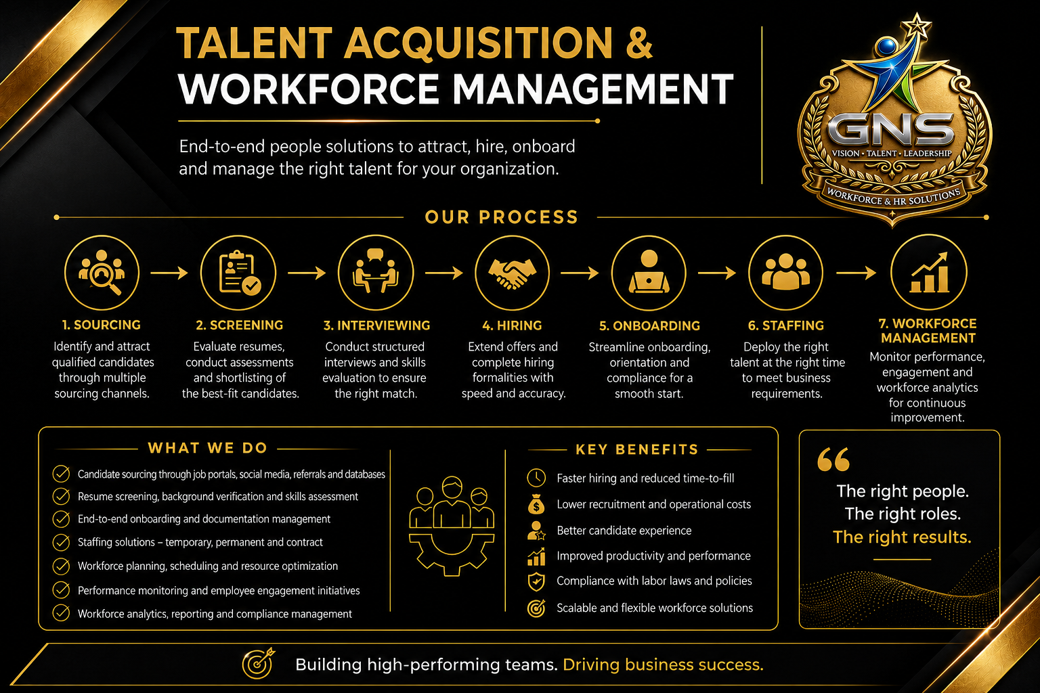

Slide 4
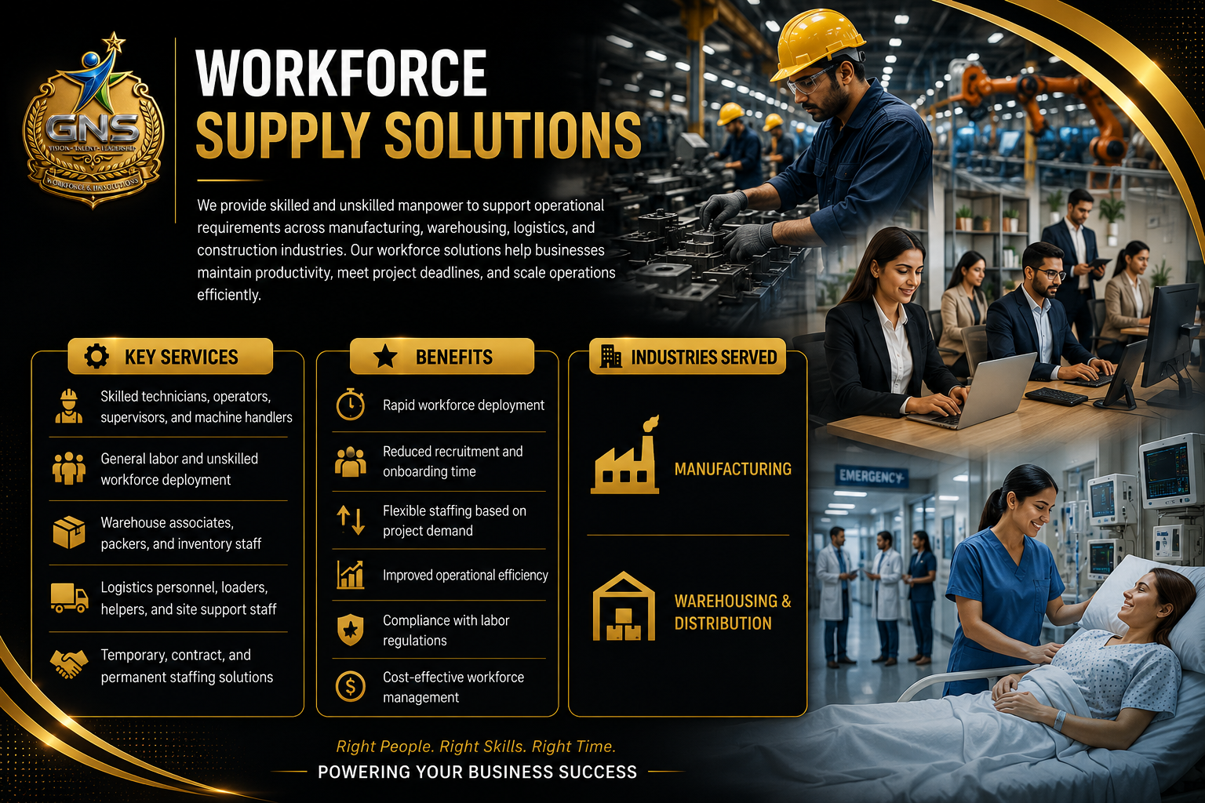

Slide 5
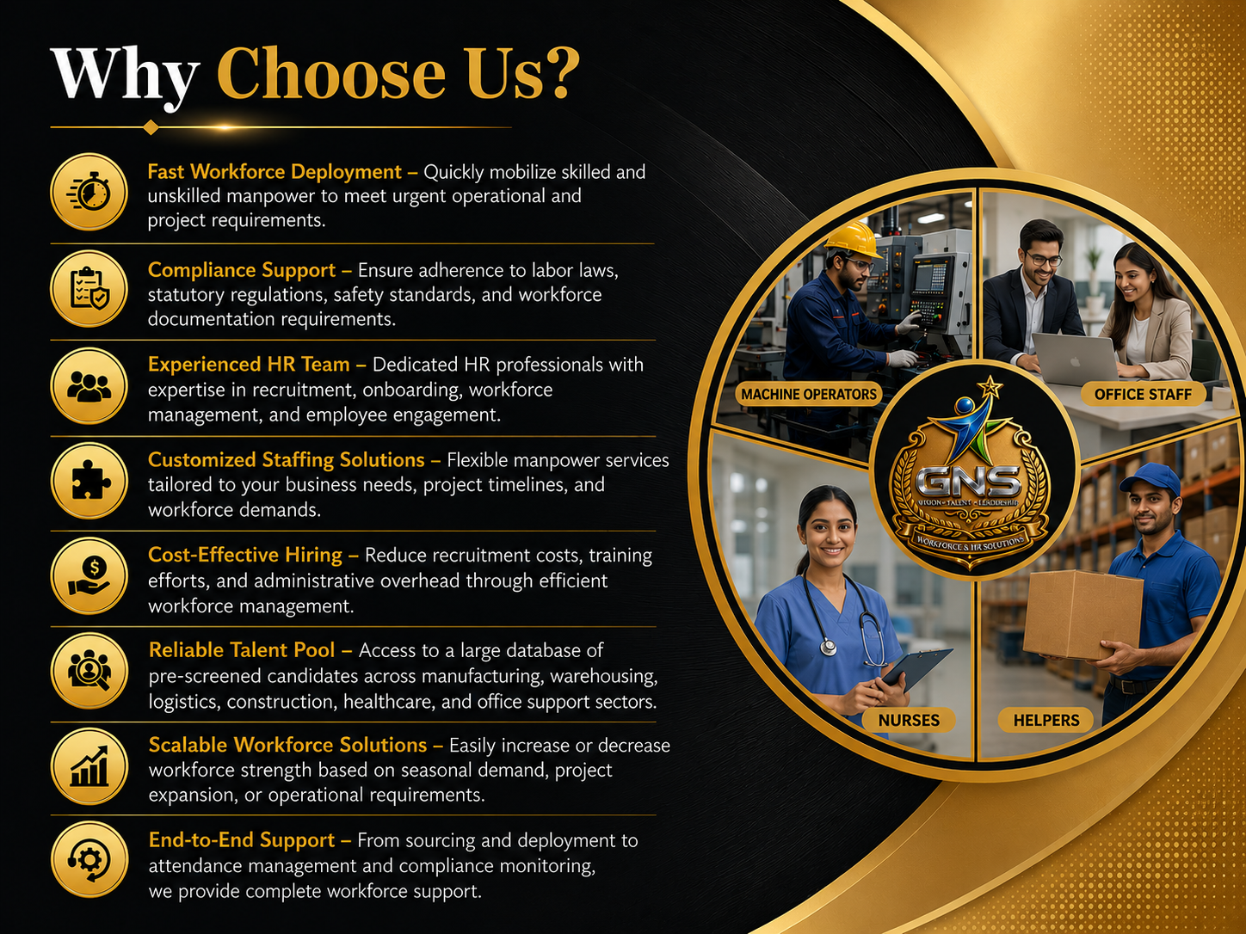

Slide 6
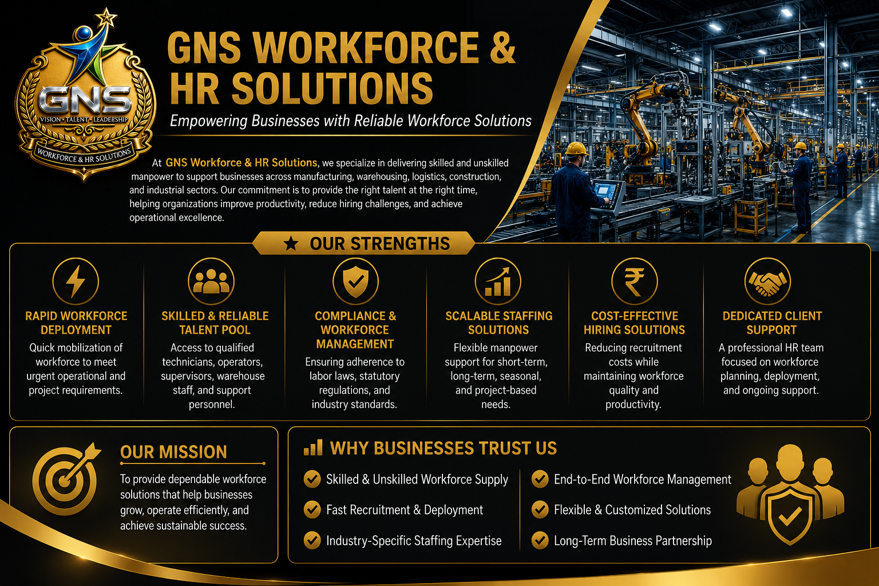

Slide 7
